Slide 1
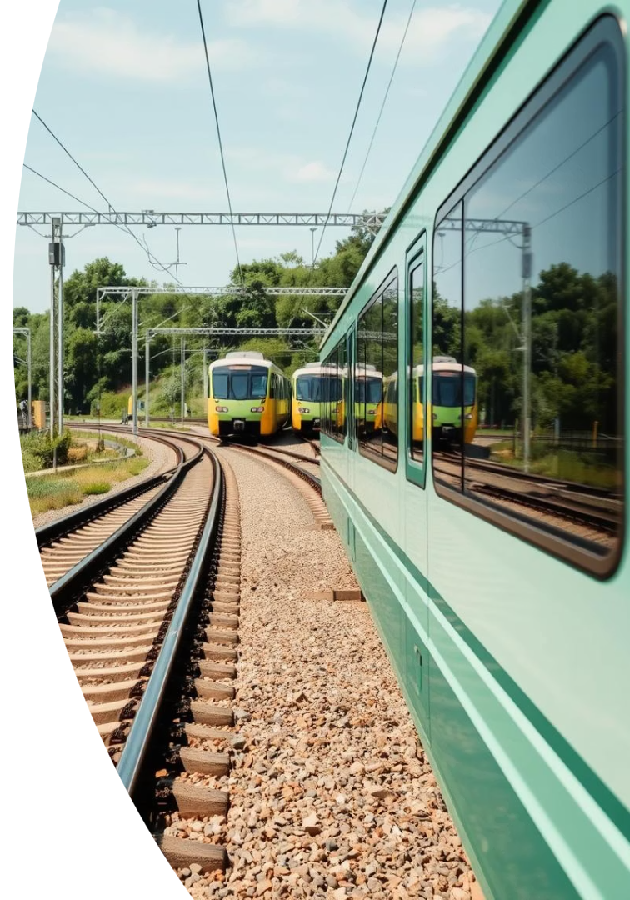
Railway Deadlock Simulation Using Banker's Algorithm
Simulating railway deadlocks to ensure safe track management.
By Yash Amte, Akshay Pise, Rohit Bharti, Prathamesh Dhomne

Slide 2
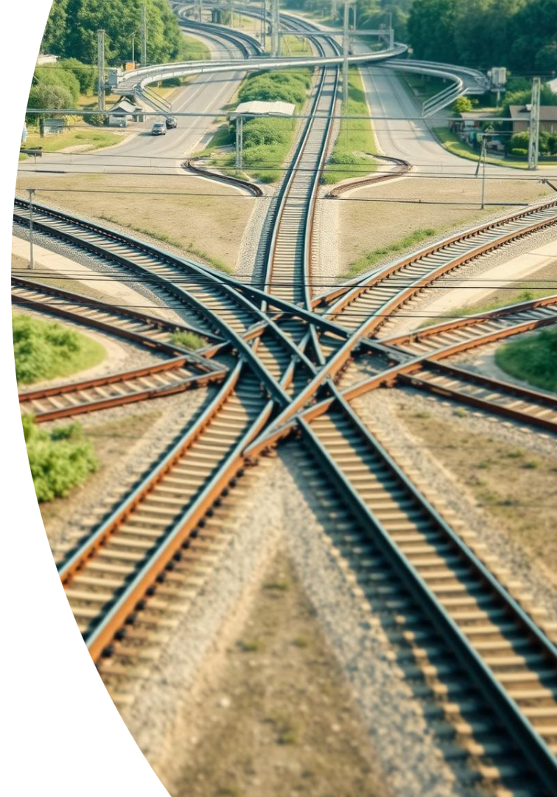
Introduction to Deadlock in Railways
Deadlock Concept
Causes
Blocking where trains wait indefinitely for tracks
Multiple trains requiring shared tracks simultaneously
Impact
Delays, safety hazards, inefficiencies

Slide 3
Banker's Algorithm Overview
Purpose
Core Idea
Application
Detect and avoid deadlocks by checking safe states
Ensure each resource allocation keeps system safe
Allocating tracks without causing deadlocks

Slide 4
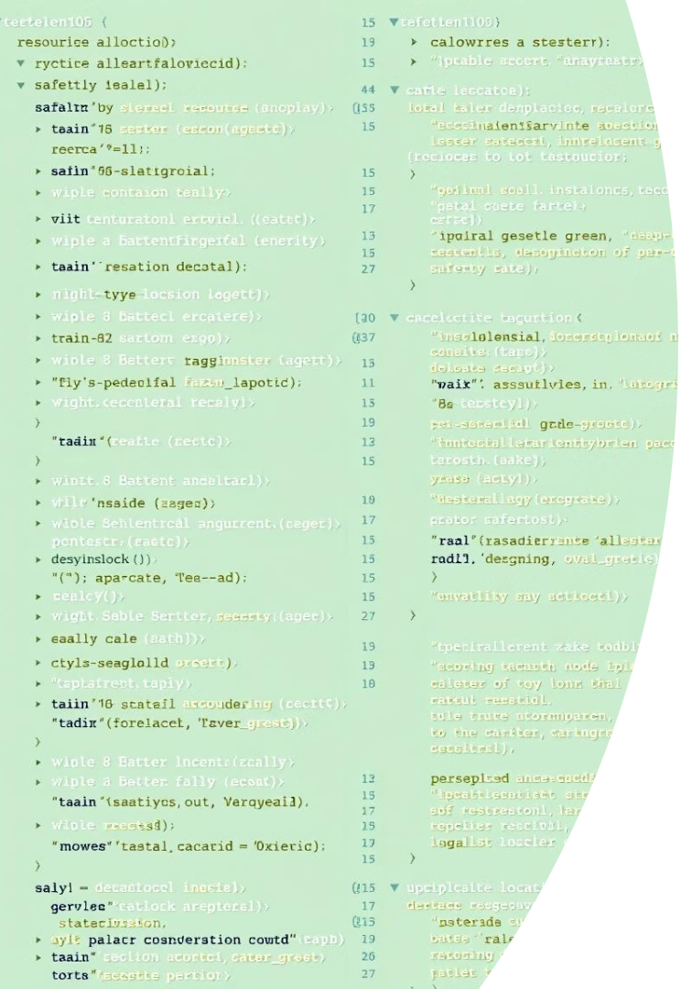
System Design & Implementation
C Language
Python HTTP Server
Core logic of Banker's algorithm for track allocation
Backend CGI server handles user input requests
HTML & CSS
Frontend interface for train and track input

Slide 5
User Interaction and Input
Input Parameters
Process
Number of trains
User submits data to server for simulation
Number of tracks
Track allocation requests

Slide 6
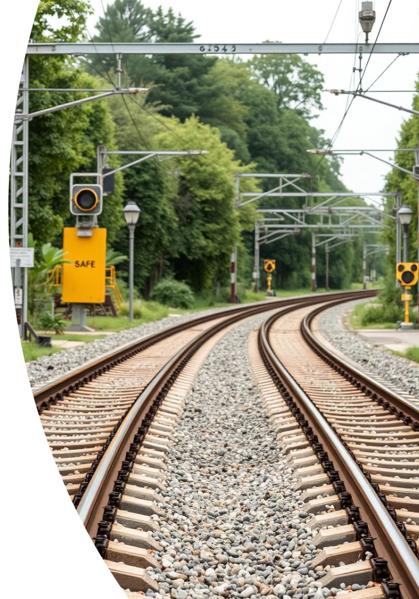
Simulation Output & Results
Safe State
Unsafe State
Tracks allocated without causing deadlock
Potential deadlock detected, requires action

Slide 7

Additional Functionalities
README File
MIT License
Detailed setup and usage instructions
Open-source permissions and legal terms
Extra Features
Extensions for better usability and documentation

Slide 8

Conclusion & Future Work
Validate Safe Operations
Ensure no deadlocks in real-time railway control
Enhance Interface
Improve frontend usability and visualization
Extend Algorithm
Adapt for dynamic track and train scenarios
Improving railway deadlock prevention for safe, efficient transport systems.

